Slide 2
North Greenwood
Community Redevelopment Area Plan
Workshop #3 June 13, 2022 (6:30 to 8:15 PM)
North Greenwood Recreation Center
2

Slide 3
North Greenwood
Community Redevelopment Area Plan
Welcome & Opening Remarks
Mayor Frank Hibbard – City of Clearwater
3
Notes:
Thomas reminds everyone of the SWOT results with an overarching presentation of slides 8-17.

Slide 4
Agenda
Workshop #1 – SWOT Exercise Results
Workshop #2 – Neighborhood Framework Exercise Results
Group Activity – Electronic Survey
Place Based Strategy Discussion
Next Steps
Elks Lodge Property Status
4
Notes:
Neale provides overview of the agenda.

Slide 5
Consultant Team
Prime Consultant & Authorship
Neale Stralow, Project Manager
Roberta Fennessy, Director
Jared Jones, Community Planner
Ivy Clinton, Sr. LA
Special Advisor / QAQC
Michael English (ME)
D/E/I / Engagement
Thomas Huggins III
Emily Rogers
Urban Design / Housing
Mickey Jacob
5
Notes:
Neale introduces team

Slide 6
Workshop Guiding Tenants
All opinions are valued. Feel free to express yours.
Allow everyone opportunity to speak.
Engage in constructive and productive dialogue.
Ask questions for clarity. Provide honest answers.
Respect and build on the strength that diverse perspectives offer!
Note: Portions of this event are being photo/video recorded which may be used in City publications.
6
Notes:
Neale reminds everyone of recording, photos, and participation etiquette.

Slide 7
North Greenwood
Community Redevelopment Area Plan
Workshop #1 – SWOT Exercise Results
Ariel Business Group – Thomas Huggins III
7
Notes:
Thomas reminds everyone of the SWOT results with an overarching presentation of slides 8-17.

Slide 8
STRENGTHS Recreation Center Parks Curtis Museum Library Greenwood Panthers Football Pinellas Trail | WEAKNESSES Sidewalks Drugs Public Amenities Housing Stock Traffic Speed Membership Costs
OPPORTUNITIES Stevenson Creek Jack Russell ELKs Lodge Trade School Local Businesses Pinellas Trail Development Diversity Sidewalks Commercial Business Corridors Education Events Vacant Lots Museum | THREATS Gentrification Drugs Crime Housing Costs Homelessness Aging In Place Displacement Resources Blue = People Based Topic Black = Place Based Topic
8
Notes:
Thomas – new enlarged slide that represents major topic consensus and People / Place Based Topics

Slide 9
North Greenwood
Community Redevelopment Area Plan
Workshop #2 – Neighborhood Framework Exercise Results
Neale Stralow – VHB
9
Notes:
Neale presents slides 18-41 reminding participants of Workshop #2 small group exercise and mapping results.

Slide 10
Florida Statutes, Chapter 163.362 – Contents of community redevelopment plan
Legal description
Diagrammatic plan and description
Neighborhood impact element
Capital improvement program
Adequate safeguards
Residential use
Statement of project costs
Completion time
10
Notes:
The diagrammatic plan is a Florida Statutes requirement

Slide 11
Kevin Lynch’s – Image of The City (1960)
5 Basic Elements of Wayfinding
Source: The University of Manchester
11
Notes:
We asked everyone to use Kevin Lynch’s urban framework elements and map / describe where they exist in North Greenwood

Slide 12
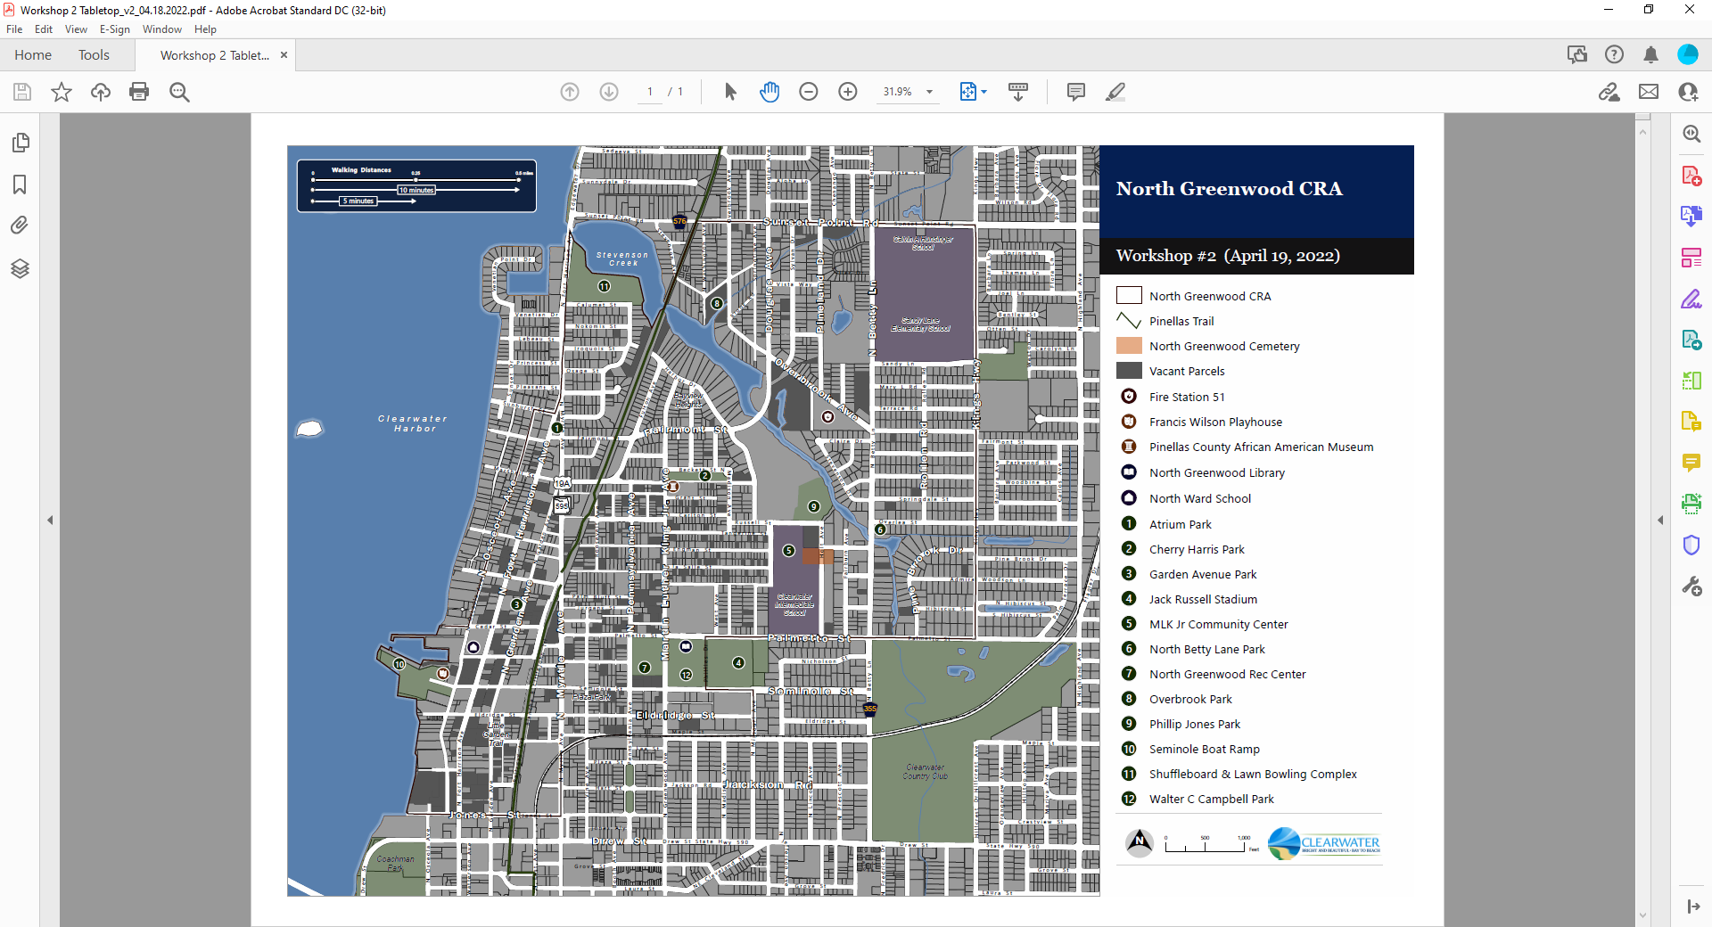
Locations
Paths
Edges
Districts
Nodes
Landmarks
12
Notes:
All Paths reporting shown:
Pinellas Trail, N. MLK Jr. Ave, N Betty Lane, Kings Hwy

Slide 13
Locations
Paths
Edges
Districts
Nodes
Landmarks
13
Notes:
All Edges reporting shown:
Stevenson Creek
CSX Railroad, Pinellas Trail, N Betty Lane, Waterfront, Downtown

Slide 14
Locations
Paths
Edges
Districts
Nodes
Landmarks
14
Notes:
All Districts reporting shown:
N. MLK Jr Ave business district, Curtis Museum/Cherry Harris Park Recreational uses, North Ward/Seminole Boat Ramp, Residential areas

Slide 15
Locations
Paths
Edges
Districts
Nodes
Landmarks
15
Notes:
All Nodes reporting shown:
N. MLK Jr Ave/Palmetto St, N. Fort Harrison/Myrtle Ave Sunset Point Road

Slide 16
Locations
Paths
Edges
Districts
Nodes
Landmarks
16
Notes:
All Landmarks reporting shown:
N. MLK Jr. Ave, Curtis Museum, Rec Center, Cemetery, Schools, North Ward

Slide 17
Composite Response
Paths
Edges
Districts
Nodes
Landmarks
17
Notes:
A composite map shows where overlap and distance exists between the 5 neighborhood elements

Slide 18
Potential CRA Plan Goals
Residential Housing
- Protect, Improve, and Options
Commercial Business
- Improve, Local Ownership, and Corridor Activity
Infrastructure Capacity
- Walkability, Speeding, and Beautification
Culture and Community
- History, Identity, and Partnerships
Recreation and Open Space
- Water Access, Amenities, and Safety
18
Notes:
We asked everyone to use Kevin Lynch’s urban framework elements and map / describe where they exist in North Greenwood

Slide 19
North Greenwood
Community Redevelopment Area Plan
Group Activity – Electronic Survey
Neale Stralow – VHB
Thomas Huggins III – Ariel Business Group
Mickey Jacob – GMC
19
Notes:
Neale – switch to Turning Point presentation slide deck to facilitate survey.

Slide 20
North Greenwood
Community Redevelopment Area Plan
Place Based Strategy Discussion
Neale Stralow – VHB
Mickey Jacobs – GMC
20
Notes:
Neale – switch to Turning Point presentation slide deck to facilitate survey.

Slide 21
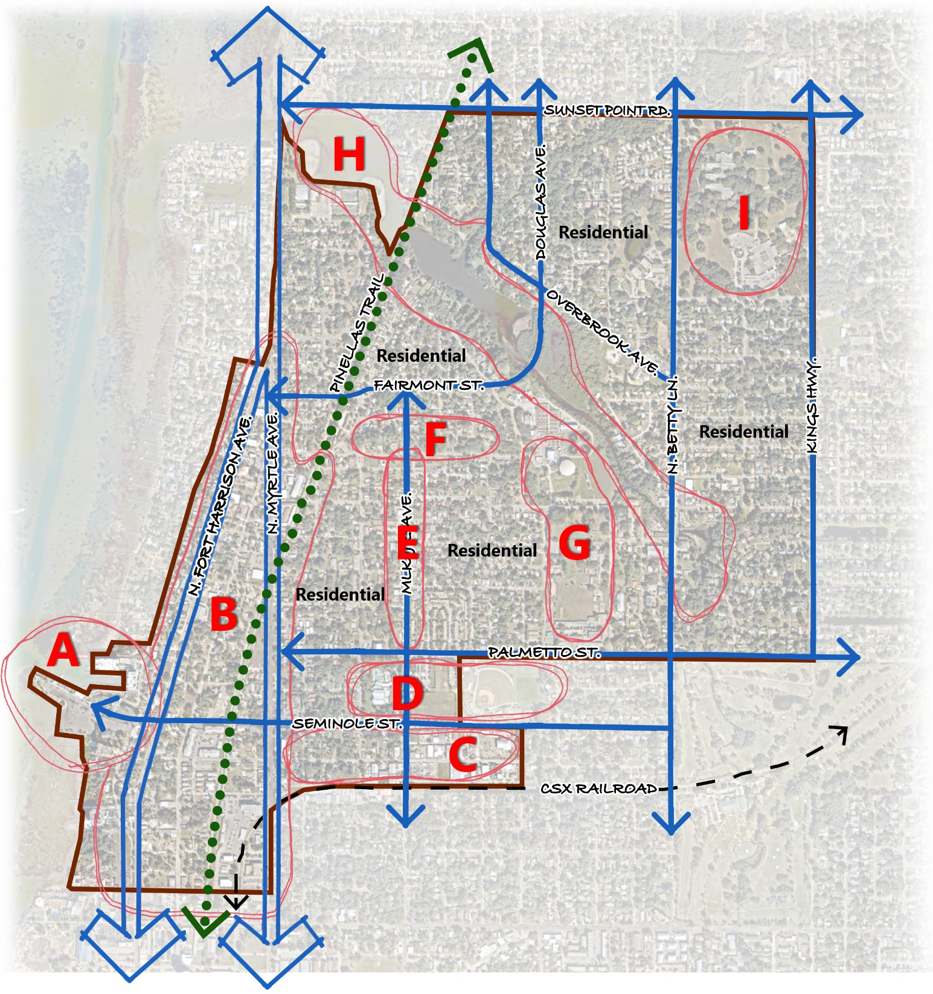
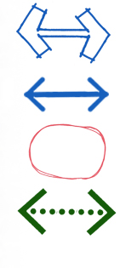
Workshop #3 (June 13, 2022)
Framework Diagram
Major Roads
Minor Roads
Emphasis Areas
Pinellas Trail
North Ward/Seminole Boat Ramp
N. Ft Harrison Ave/N. Myrtle Ave/Pinellas Trail
CSX Industrial Area/Armory
N. Greenwood Recreation Center/Library
N. MLK Jr. Ave Corridor
Curtis Museum/Cherry Harris Park
Clearwater Intermediate School/ MLK Neighborhood Center/Park/Cemetery
Stevenson Creek/Shuffleboard/Lawn Bowling
Hunsinger/Sandy Lane Schools

Slide 22
Area A – North Ward School / Seminole Boat Ramp
Comments We Heard
City historic designation, great architecture
Desire for a community use
Potential CRA Plan Opportunities
Include bike/ped connections and routes to link the neighborhood
Area governed by Clearwater Downtown Redevelopment Plan
22
Notes:
We asked everyone to use Kevin Lynch’s urban framework elements and map / describe where they exist in North Greenwood

Slide 23
Area B – N. Ft Harrison Ave / N. Myrtle Ave / Pinellas Trail
Comments We Heard
High traffic volume commercial corridors
Vacant / underused commercial parcels
Lack of identity, a through-not to place
Reduced number of users on this segment of Pinellas Trail
Potential CRA Plan Opportunities
Include commercial use incentives for both existing business improvements and new business attraction
Coordinate placemaking elements with future “Complete Street” designs for N. Ft Harrison Ave
Identify options for increased business access and orientation to Pinellas Trail
Area governed by Clearwater Downtown Redevelopment Plan
23
Notes:
We asked everyone to use Kevin Lynch’s urban framework elements and map / describe where they exist in North Greenwood

Slide 24
Area C – CSX Industrial Area / Armory
Comments We Heard
Potential trail with rail corridor
Armory has great architecture
Employment expansion
Potential CRA Plan Opportunities
Identify bike/ped connections and routes to link with neighborhood
Possible adaptive reuse of Armory if not needed by City in future
24
Notes:
We asked everyone to use Kevin Lynch’s urban framework elements and map / describe where they exist in North Greenwood

Slide 25
Area D - N. Greenwood Recreation Center / Library
Comments We Heard
Heart of the neighborhood and community assets
Great facilities and use
Potential CRA Plan Opportunities
Enhance community access
Identify opportunities for expanded youth programs
Event parking options
25
Notes:
We asked everyone to use Kevin Lynch’s urban framework elements and map / describe where they exist in North Greenwood

Slide 26
Area E – N. MLK Jr. Ave Corridor
Comments We Heard
Traditional local business corridor
Vacant and underused commercial and adjacent vacant residential parcels
Redevelop City parcels
Potential CRA Plan Opportunities
Include commercial use incentives for both existing business improvements and new business attraction
Identify redevelopment opportunities and conditions for City owned parcels
26
Notes:
We asked everyone to use Kevin Lynch’s urban framework elements and map / describe where they exist in North Greenwood

Slide 27
Area F – Curtis Museum / Cherry Harris Park
Comments We Heard
Great architecture, possible adaptive reuse of 2nd floor
Protect and enhance Curtis Museum on 1st floor
Potential CRA Plan Opportunities
Coordinate with School District and Museum, seek additional adaptive reuse alternatives
Redevelopment of adjacent parcels
27
Notes:
We asked everyone to use Kevin Lynch’s urban framework elements and map / describe where they exist in North Greenwood

Slide 28
Area G – Clearwater Intermediate School / MLK Neighborhood Center / Park / Cemetery
Comments We Heard
Community assets, recreation, open space
Need recognition and cemetery memorial
Facility odors
Potential CRA Plan Opportunities
Coordinate with School District and identify potential memorial treatments
Enhance beauty and increase access
28
Notes:
We asked everyone to use Kevin Lynch’s urban framework elements and map / describe where they exist in North Greenwood

Slide 29
Area H – Stevenson Creek / Shuffleboard / Lawn Bowling
Comments We Heard
Increase recreational access to waterfront
Possible kayak, canoe, paddleboard launch
Potential CRA Plan Opportunities
Protect existing natural and recreational uses
Identify key locations along existing City properties to provide water launch access
29
Notes:
We asked everyone to use Kevin Lynch’s urban framework elements and map / describe where they exist in North Greenwood

Slide 30
Area I – Hunsinger / Sandy Lane Schools
Comments We Heard
Safe routes and connections
Underutilized open space lands
Youth access to recreational courts
Potential CRA Plan Opportunities
Identify bike/ped connections and student routes to neighborhood
Identify infill development opportunities for School District owned parcels
30
Notes:
We asked everyone to use Kevin Lynch’s urban framework elements and map / describe where they exist in North Greenwood

Slide 31
Next Steps
Workshop #1 – Where Are We Now?
Thursday, February 24, 2022 (6:30 PM-8:15 PM)
Workshop #2 – Where Are We Going?
Tuesday, April 19, 2022 (6:30 PM)
Workshop #3 – Where Do We Want to Go?
Monday, June 13, 2022 (6:30 PM)
Workshop #4 – How Do We Get There?
Tuesday, August 2, 2022 (6:30 PM)
31

Slide 32
North Greenwood
Community Redevelopment Area Plan
Elks Lodge Property Status
Chuck Lane – City of Clearwater
32
Notes:
Neale – switch to Turning Point presentation slide deck to facilitate survey.

Slide 33
Thank you !
If you have any questions or comments, please contact:
Dylan Prins
Planning & Development Dept.
ngreenwoodcra@myclearwater.com
Sign up for project updates:
www.ngreenwoodcra.com
33

